Slide 1
Activation Function in Deep Learning

Slide 2
Activation function
In artificial neurons inputs and weights are given from which the weighted sum of input is calculated, and then it is given to an activation function that converts it into the output.
The input is fed to the input layer, the neurons perform a linear transformation on this input using the weights and biases.
x = (weight * input) + bias
An activation function is applied on the above result.
Y= Activation ( Σ (weight * input) + bias )

Slide 3
Activation function helps a neural network to learn complex relationships and patterns in data.
Now the question is what if we don’t use any activation function and allow a neuron to give the weighted sum of inputs as it is as the output.
In this case computation will be very difficult as the weighted sum of input doesn’t have any range and depending upon input it can take any value. Hence one important use of the activation function is to keep output restricted to a particular range.
Another use of activation function is to add non-linearity in data.

Slide 5
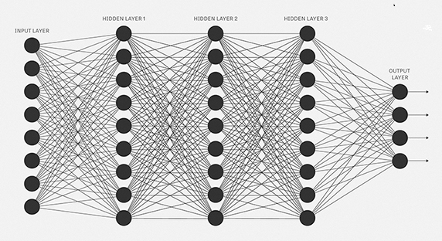
In Neural Network, output from the activation function moves to the next hidden layer and the same process is repeated. This forward movement of information is known as the forward propagation.

Slide 6
Using the output from the forward propagation, error is calculated. Based on this error value, the weights and biases of the neurons are updated. This process is known as back-propagation.
Non-linearity is important in neural networks because linear activation functions are not enough to form a universal function approximator.
Most of the real-world problems are very complex we need non-linear activation functions in a neural network.
Neural Network without non-linear activation functions will be just a simple linear regression model.

Slide 7
Vanishing gradient problem
In neural networks during back propagation, each weight receives an update proportional to the partial derivative of the error function. In some cases, this derivative term is so small that it makes updates very small. Especially in deep layers of the neural network, the update is obtained by multiplication of various partial derivatives.
If these partial derivatives are very small then the overall update becomes very small and approaches zero. In such a case, weights will not be able to update and hence there will be slow or no convergence. This problem is known as the Vanishing gradient problem.

Slide 8
Exploding gradient problem.
Similarly, if the derivative term is very large then updates will also be very large. In such a case, the algorithm will overshoot the minimum and won’t be able to converge. This problem is known as the Exploding gradient problem.
There are various methods to avoid these problems. Choosing the appropriate activation function is one of the them.

Slide 9
Various Activation function
Binary Step Function :
This activation function would be a threshold based classifier means whether or not the neuron should be activated based on the value from the linear transformation.
In other words, if the input to the activation function is greater than a threshold, then the neuron is activated, else it is deactivated, means its output is not considered for the next hidden layer. Let us look at it mathematically:
f(x) = 1, when x>=0
= 0, when x<0

Slide 10
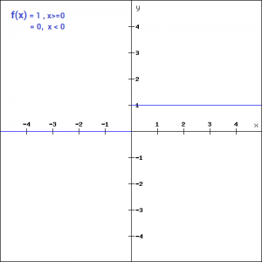
Pros-
Easy to compute.
Binary / Linear Classifier
Cons-
The gradient of the function is zero, the weights and biases don’t update. The problem with a step function is that it does not allow multi-value outputs—for example, it cannot support classifying the inputs into one of several categories

Slide 12
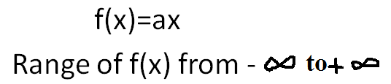
2. Linear Function
The problem with the binary step function is that - the gradient of the function became zero since there is no component of x is used in the binary step function.
Then instead of a binary function, we can use a linear function. We can define the function as-

Slide 13
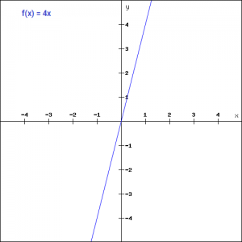
Pros-
Easy to compute.
the gradient here does not become zero, but it is a constant, so the weights and biases will be updated during the back propagation process but the updating factor would be the same.
Cons-
The neural network will not really improve the error since the gradient is the same for every iteration. The network will not be able to train well and capture the complex patterns from the data.
Uses : Linear activation function is used at just one place i.e. output layer

Slide 14
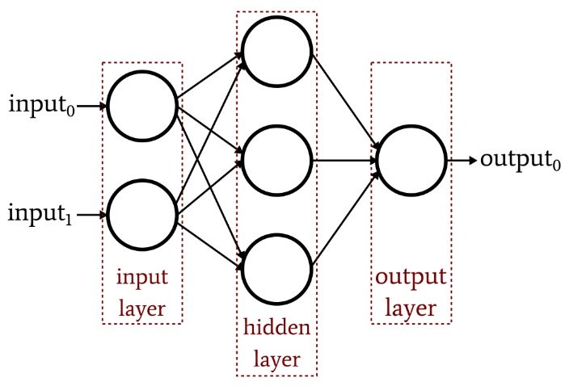

Slide 16
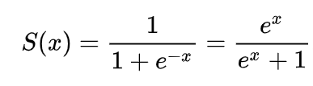
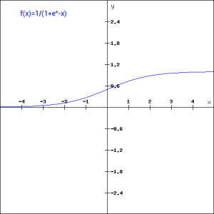
3. Sigmoid Function-
Sigmoid is an ‘S’ shaped non-linear mathematical function whose formula is-

Slide 17
Pros-
Sigmoid Function is continuous and differentiable.
It will limit output between 0 and 1
Very clear predictions for binary classification.
Cons-
It can cause the vanishing gradient problem.
It’s not centered around zero.
Computationally Expensive
Uses : Usually used in output layer of a binary classification, where result is either 0 or 1, as value for sigmoid function lies between 0 and 1 only so, result can be predicted easily to be 1 if value is greater than 0.5 and 0 otherwise

Slide 18
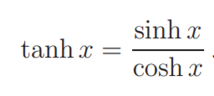
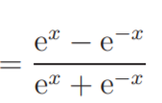
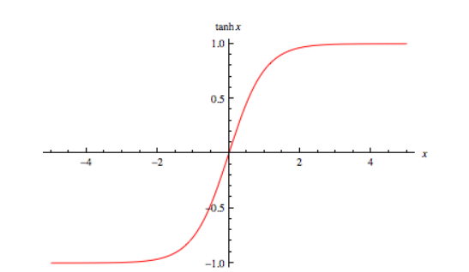
4. Hyperbolic Tangent (Tanh)
It is very similar to the sigmoid function. It is centered at zero and has a range between -1 and +1.

Slide 19
Pros-
It is continuous and differentiable everywhere.
It is centered around zero.
It will limit output in a range of -1 to +1.
Cons-
It can cause the vanishing gradient problem.
Computationally expensive.
Uses :- Usually used in hidden layers of a neural network as it’s values lies between -1 to 1 hence the mean for the hidden layer comes out be 0 or very close to it, hence helps in centering the data by bringing mean close to 0. This makes learning for the next layer much easier.

Slide 21

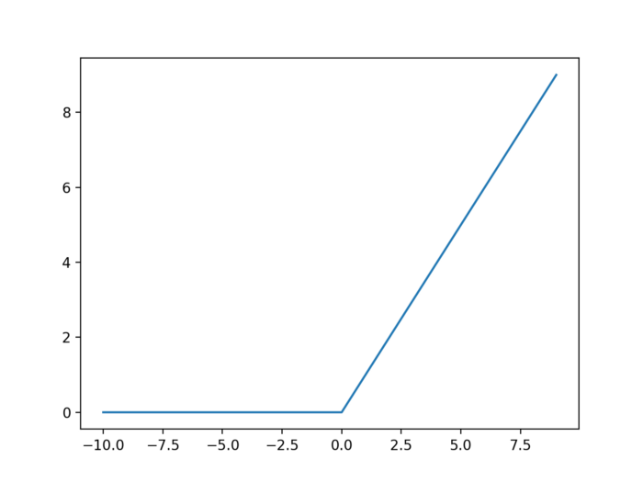
5. Relu-
Rectified linear Unit often called as just a rectifier or relu is-

Slide 22
Pros-
Easy to compute.
Does not cause vanishing gradient problem
As all neurons are not activated, this creates sparsity in the network and hence it will be fast and efficient.
Cons-
Cause Exploding Gradient problem.
Not Zero Centered.
Can kill some neurons forever as it always gives 0 for negative values.
Uses :- ReLu is less computationally expensive than tanh and sigmoid because it involves simpler mathematical operations. At a time only a few neurons are activated making the network sparse making it efficient and easy for computation

Slide 23
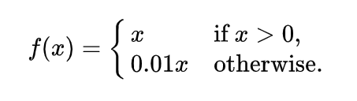
6. Leaky Relu-
Leaky relu is the improvement of relu function. Relu function can kill some neurons in each iteration, this is known as dying relu condition. Leaky relu can overcome this problem, instead of giving 0 for negative values, it will use a relatively small component of input to compute output, hence it will never kill any neuron.

Slide 24
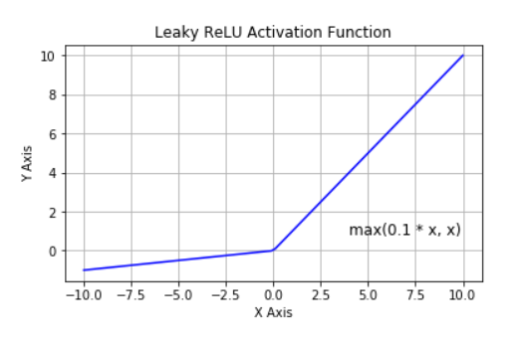
Pros-
Easy to compute.
Does not cause vanishing gradient problem
Does not cause the dying relu problem.
Cons-
Cause Exploding Gradient problem.
Not Zero Centered

Slide 27
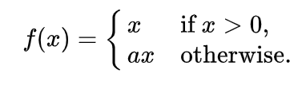
7. Parameterized Relu-
In parameterized relu, instead of fixing a rate for the negative axis, it is passed as a new trainable parameter which network learns on its own to achieve faster convergence.

Slide 28
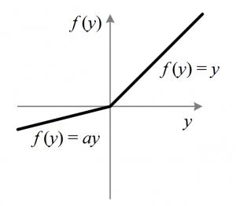
Pros-
The network will learn the most appropriate value of alpha on its own.
Does not cause vanishing gradient problem
Cons-
Difficult to compute.
Performance depends upon the problem.

Slide 29

8. Swish
The swish function is proposed by Google’s Brain team. Their experiments show that swish tends to work faster than Relu of deep models across several challenging data sets.
The swish function is obtained by multiplying x with the sigmoid function.

Slide 30
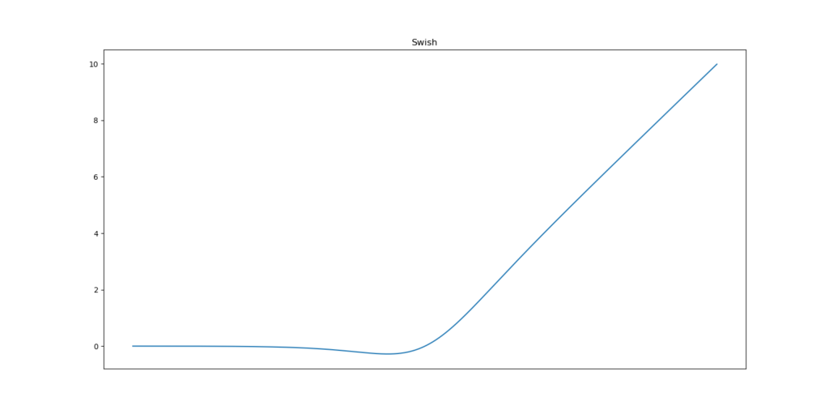
Pros-
Does not cause vanishing gradient problem.
Proven to be slightly better than relu.
Cons-
Computationally Expensive

Slide 31
9. Softmax Function
Softmax Function is a generalization of sigmoid function to a multi-class setting. It’s popularly used in the final layer of multi-class classification. It takes a vector of ‘k’ real number and then normalizes it into a probability distribution consisting of ‘k’ probabilities corresponding to the exponentials of the input number. Before applying softmax, some vector components could be negative, or greater than one, and might not sum to 1 but after applying softmax each component will be in the range of 0–1 and will sum to 1, and hence they can be interpreted as probabilities.

Slide 32
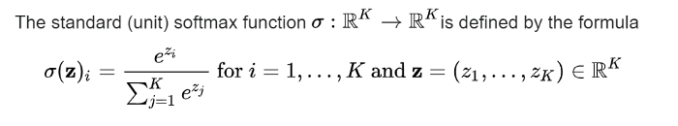
Pros-
It can be used for multiclass classification and hence used in the output layer of neural networks.
Cons-
It is computationally expensive as we have to calculate a lot of exponent terms.

Slide 33


10. Softplus and Softsign
Softplus function is -
Its derivative is a sigmoid function.
SoftSign function is-
Softplus and Softsign are not much used and generally, relu and its variants are preferred over them.
Pros-
Does not cause vanishing gradient problem.
Cons-
Computationally expensive.
Slower than Relu.

Slide 34
Choosing the right Activation Function
Sigmoid functions and their combinations generally work better in the case of classifiers.
Sigmoids and tanh functions are sometimes avoided due to the vanishing gradient problem.
ReLU function is a general activation function and is used in most cases these days.
If we encounter a case of dead neurons in our networks the leaky ReLU function is the best choice.
Always keep in mind that ReLU function should only be used in the hidden layers.
As a rule of thumb, you can begin with using ReLU function and then move over to other activation functions in case ReLU doesn’t provide with optimum results.

